Slide 1
WELCOME TO CHEM. 1411 FRANK PISHVA TEXAS A&M-COMMERCE Chapter 1: Matter and Measurement

Slide 2
CHAPTER 1
LEARNING OBJECTIVES:
1. DEFINE CHEMISTRY
2. DESCRIBE THE SCIENTIFIC METHOD
3. NAME SI UNITS
4. PERFORM UNIT CONVERSIONS
5. PERFORM DENSITY CALCULATIONS
6. APPLY RULES OF SIGNIFICANT FIGURES
HOMEWORK:
11, 17, 23, 30, 33, 39, 41, 43, 51, 55, 57,59,61,69,71,75, 77, 79, 81, 83, 87, 89, 103

Slide 3
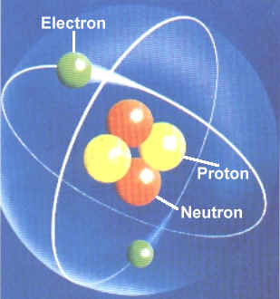
Atoms
Atoms: Greek for indivisible.
Originally thought to be the smallest indivisible component of matter
Later found there are subatomic charged particles which could be divided
Atom is the smallest basic unit that defines elements on periodic table
All single elements on periodic table are characterized by atoms
http://www.eskom.co.za/nuclear_energy/fuel/atom.jpg

Slide 4
Molecules
Molecules: two or more atoms joined together in a specific arrangement
Example: H₂O
2 Hydrogen atoms and 1 oxygen atom
Properties of molecules depends on the atoms they are composed

Slide 5
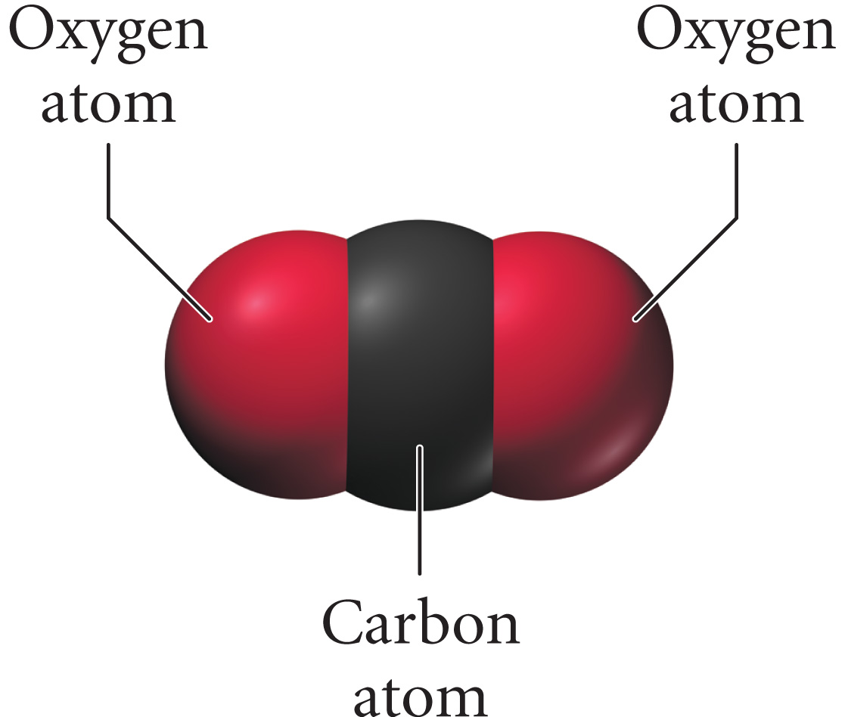
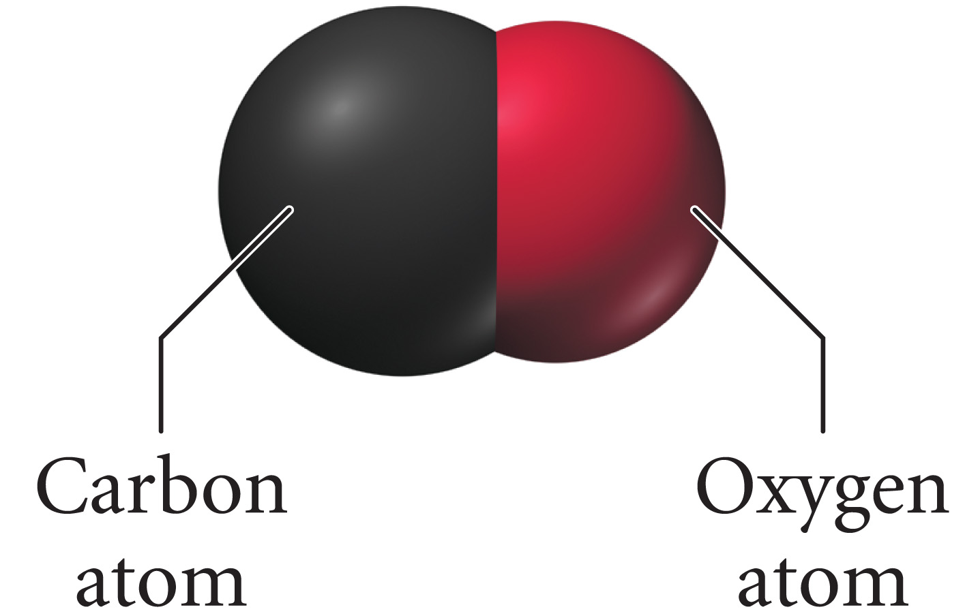
Structure Determines Properties
the properties of matter are determined by the atoms and molecules that compose it
carbon monoxide
carbon dioxide
composed of one carbon atom and one oxygen atom
colorless, odorless gas
burns with a blue flame
binds to hemoglobin
composed of one carbon atom and two oxygen atoms
colorless, odorless gas
incombustible
does not bind to hemoglobin

Slide 6
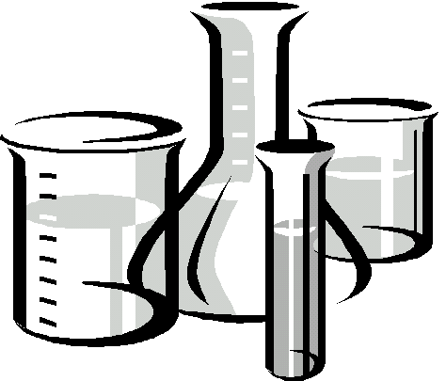
Chemistry Defined
Chemistry: Science that studies the behavior of matter by studying the behavior of atoms and molecules
Question: Give an example of a molecule and an atom
http://www.maine.gov/dhhs/eng/water/images/beakers.jpg

Slide 7
Scientific Approach to Knowledge
Based on observation and knowledge
Quantitative: measuring or quantifying the process (using numbers and measurements)
Qualitative: Descriptively describing the process
http://www.perse.co.uk/uploads/Chemistry_4.jpg

Slide 8
Scientific Method Steps
http://www.sciencebuddies.org/mentoring/overview_scientific_method2.gif

Slide 9
Classification of Matter
Matter: Anything that occupies space and has mass
Your body
Your books
Air, etc
Thought question: Name something that is not matter?
3 forms of matter:
Solid
Liquid
Gas

Slide 10
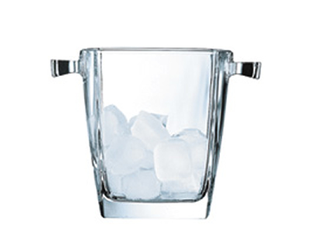
Solid
Solid
Molecules packed close together in fixed location
Fixed volume
Rigid shape
Examples: Ice, diamonds
http://www.sciencekids.co.nz/images/pictures/experiments/icecubes.jpg

Slide 11
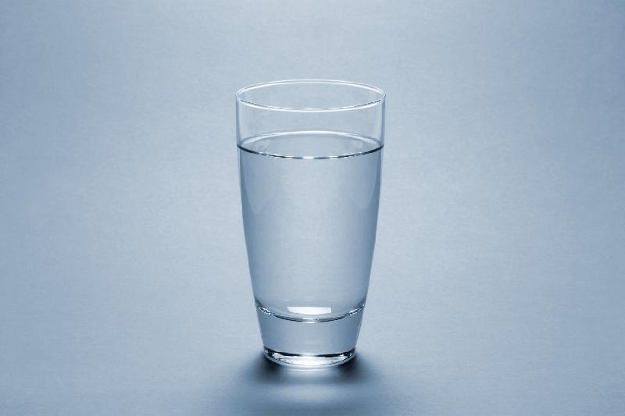
Liquid
Liquid
Molecules not as closely packed as liquid
Free moving
Fixed volume
No fixed shape: takes the shape of container
Examples: water, alcohol
http://www.wesa.ca/en/data/files/download/Service_Pages/iStock_000001700465Medium_Water%20in%20Glass.jpg

Slide 12
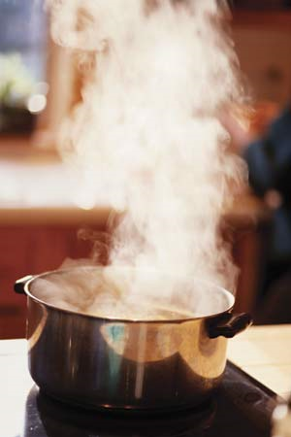
Gas
Gas
Molecules have a lot of space between them
Free to move
Compressible: forcing gas into a small container
No fixed volume: volume of the container
No fixed shape: take the shape of container
Examples: Helium and Nitrogen
http://cache.eb.com/eb/image?id=93820&rendTypeId=4

Slide 13
Solid, Liquid, Gas Summary

Slide 14
Question: Solid, liquid, gas
Question: give one example of a solid, liquid and a gas

Slide 15
Classification of Matter according to Composition
Matter
Pure Substance
Element
Compound
Mixture
Heterogeneous
Homogeneous

Slide 16
Classification of Pure Substances
made of one type of atom (some elements found as multi-atom molecules in nature)
combine together to make compounds
made of one type of molecule, of different atoms
compounds contain 2 or more different kinds of atoms
Note: When two or more of the same atom or different atoms combine = Molecule

Slide 17
Mixture
Mixture: a substance made by combining two or more different materials without a chemical reaction occurring
Can be broken down by heating, filtering, dissolving, etc
Can still be separated because no new product formed
No chemicals are bonded together
Examples: Sand, sugar tea
2 types of mixtures:
Heterogeneous
Homogeneous

Slide 18
Classification of Mixtures
made of multiple substances, whose presence can be seen
portions of a sample have different composition and properties
made of multiple substances, but appears to be one substance
all portions of a sample have the same composition and properties

Slide 19
Methods of Seperating Mixtures
Evaporation: liquid to gas. volatile liquids (evaporate easily) can be evaporated from a mixture. Example Salt Water
Distillation: Separate mixtures based on difference in boiling points
Filtration: A solid is filtered from a liquid. Example: spaghetti noodles from water.
Decantation: pouring out liquid to separate from solid. (separate sand and water)

Slide 20
Physical and Chemical Properties
Physical Property: A property a substance displays without changing its composition. Alter only state or appearance but not the chemical composition
Melting point
Boiling point
Density, etc
Smell
Chemical Property: A property a substance displays by changing it composition ( a chemical reaction). How a chemical behaves when reacts with another substance
Burning
Flammability
Toxicity
Acidity

Slide 21
Question: Physical vs Chemical
Classify as a chemical or a physical change
Evaporation of alcohol
Burning of oil
Bleaching hair
Frost formation
Answers:
Evaporation of alcohol: Physical
Burning of oil: Chemical
Bleaching hair: Chemical
Frost formation: Physical

Slide 22
Chapter 1
Continued

Slide 23
Units of Measurement
Units: Standard quantities used to specify measurements
2 systems:
English
Inches,
Yards
Miles, etc
Metric
Meter
Kilometer, etc
Scientist use Metric system with standard units called SI units: International System of Units

Slide 24
SI Units
http://wps.prenhall.com/wps/media/objects/165/169061/GIFS/table1.4.gif

Slide 25
Temperature
Important temperature conversions:
°C = (°F-32)/1.8
K = °C + 273.15
A child sick child is running a temperature of 40 °C. What is her Temperature in K and °F ?

Slide 26
Metric System Prefixes
Need to be able to convert back and forth between prefixes
http://www.radioing.com/hamradio/metric.gif

Slide 27
Metric Conversions
http://www.globalsecurity.org/security/library/policy/army/fm/3-11-22/taba-1.gif

Slide 28
Practice on Board
12.5 in to cm
3 cm² to in²
5.70 L to in³
1.76 Mi to m ( )

Slide 29
Derived Units
A derived unit is a combinations of the SI units
Examples:
Volume: M³
Length X Width X Height
Density: mass/volume
D=m/v : SI units = Kg/ M³
Usually in units of g/mL
Physical property
“heaviness” at constant volume
Question: Oil floats on water is it more or less dense than water?

Slide 30
Significant Figures
minimum number of digits needed to write a given value without loss of accuracy.
Rules:
All whole numbers are significant
When there is a decimal all zeros to the right of whole numbers are significant ONLY
When there is no decimal only zeros between two whole numbers are significant
Exact numbers, ie numbers used in a conversion are not considered when looking at significant figures
No uncertainty so no limit in number of sig figs
We say it has unlimited sig figs

Slide 31
Question
How many significant figures in the following:
5.003
500
501
0.010
Answers:
a. 4
b. 1
c. 3
d. 2

Slide 32
Sig Figs and Calculations
Addition/Subtraction:
Add and subtract all numbers as written
Answer will have as many digits in decimal as least in question
Ex: 18.9984032
18.9984032
83.798_______
121.7948064
Final ans: 121.795
Multiplication/Division
Write answer with fewest sig figs in original question
Do not have to worry about exponents being the same
Ex: 7540.0 X 1.3= 9802.0
Final answer= 9.8X10³ or 9800

Slide 33
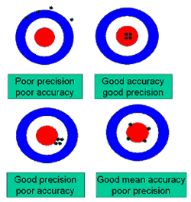
Precision vs Accuracy
Precision: how close individual measurements are to each other or reproducibility
Accuracy: How close the measured value is to the real or true value
http://www.interactive-consultancies.co.uk/FilterII/assets/images/accuracy_precision_03_250.gif

