Slide 1
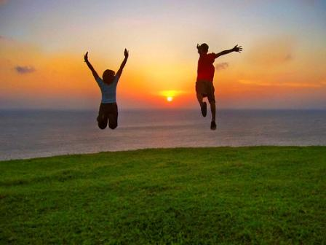
Enjoy Life: Keys to Increasing Happiness
w/Dr. Elbel

Slide 2
What is happiness? What determines happiness? What can we do to be happier?

Slide 3
Happiness doesn’t come easy
Negative emotions (fear, anger, despair) are for SURVIVAL
Positive emotions (curiosity, delight, interest, joy, etc) are for GROWTH

Slide 4
What do you think would make you happy today?

Slide 5
Believe it or not
It is not money or circumstances!

Slide 6
Humans are poor affective forecasters
We are very poor at predicting what will make us happy
Events have a small impact on happiness that doesn’t last long
People who suffer tragedy/trauma recover more quickly than they expect (resilience)
Good things don’t make us feel good as much as we expect

Slide 7
What is happiness?
Is it hedonism?

Slide 8
Our current culture
Is more interested in the pursuit of individual happiness than in the search for meaning.
Frankl would say that happiness cannot be pursued, it must ensue.
He adds—the pursuit of happiness thwarts happiness.

Slide 9
How to forecast how an event will affect us?
Look at other’s experience
How have previous lottery winners felt?
We don’t tend to do that because we think we are unique
Daniel Gilbert, 2007, Stumbling on Happiness

Slide 10
David Geffen interviewed by Barbara Walters
BW: “Now that you are a billionaire are you happy?”
DG: “Anyone who believes money makes you happy doesn’t have money”

Slide 11
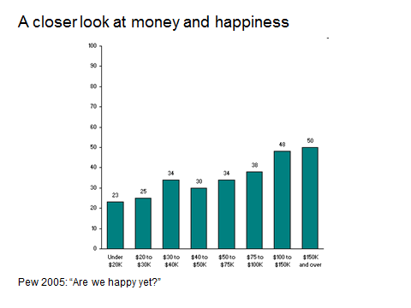
Happiness increases with income up to about 50K—after that there is no dramatic effect. (Richard Layard, Happiness: Lessons from a New Science)

Slide 13
Happiness without meaning
Characterizes a relatively shallow, self-absorbed or even selfish life

Slide 14
Happy life
Meaningful life
Happy life=taking
Meaningful life=giving

Slide 15
Victor Frankl’s observations in Nazi concentration camps led him to conclude:
The difference between those who had lived and those who died came down to one thing--Meaning

Slide 16
Those who had meaning
Were more resilient to suffering
“Everything can be taken from a man but one thing. The last of the human freedoms—to choose one’s attitude in any given set of circumstances, to choose one’s own way” Victor Frankl

Slide 17
Path to happiness according to Caroline Myss
Discovering our true paths—our meaning
Appreciating the lives we have (not the ones we want)—gratitude
Recognizing who we really are—authenticity & self acceptance

Slide 18
Nearly all people are capable of much more happiness than they have.
See your potential.
Create opportunities to invest in your own highest and best self.

Slide 19
In a meaningful life you use your highest strengths and talents to belong to and serve something that is larger than the self.
Martin Seligman
You may also have more worry, anxiety and stress because you are invested in something bigger than yourself.

Slide 20
Example: parenting
Having children is associated with a more meaningful life
Higher stress, anxiety and self sacrifice
On a day to day basis parents are less happy interacting with their children than they are exercising, eating and watching television
Daniel Gilbert, Harvard psychologist

Slide 22
Reframing
Happy people don’t have a magic button to get them out of traffic or that mutes an impolite boss—they draw different messages or meanings from the situation.
David Niven 100 Simple Secrets of Happy People

Slide 23
To improve happiness
5 random acts of kindness per week (journal it)
Gratitude journal
Gratitude letter
Connect with others
Discover your strengths and put energy into increasing strengths

Slide 25
Gratitude
A validated intervention for depression
A validated intervention to increase happiness

Slide 28
Gratitude Letter

Slide 29
Build and maintain better relationships!

Slide 30
For better relationships
Real enthusiasm after partner’s positive event most important
It’s more important than support through negative event

Slide 32
VIA survey of character strengths
At Martin Seligman’s web site:
Authentichappiness.com
You must register

Slide 34
Build on your strenghts!

Slide 36
Optimism Survey
Authentichappiness.org
Martin Seligman's website

Slide 37
Health improves happiness
Meditation
Savoring—living in the moment
Sleep
Omega-3
Enjoy Life: Healing with Happiness; How to harness positive moods to raise your energy, effectiveness and joy, by Lynn D. Johnson, 2008

Slide 38
Happiness is a positive sum game
“Thousands of candles can be lighted from a single candle, and the life of the candle will not be shortened. Happiness never decreases by being shared.” Buddha

Slide 39
Recommended Books
Enjoy Life: Healing with Happiness; How to harness positive moods to raise your energy, effectiveness and joy, by Lynn D. Johnson, 2008
Authentic Happiness: Using the New Positive Psychology to Realize Your Potential for Lasting Fulfillment , Martin Seligman, 2003

