Slide 1
08.2022
PARKER UNIVERSITY QEP
QUALITY ENHANCEMENT PLAN
DR. MANDY SMITH
972-438-6932
mandysmith@parker.edu
my.parker.edu

Slide 2
QEP SIGNATURE COURSE
TRAINING AGENDA
QEP Plan
Why a Signature Course?
Rater & Recognition Process
Questions

Slide 3
QUALITY ENHANCEMENT PLAN (QEP)
MISSION
The QEP is to improve student learning through Enhancing the Use of Evidence
GOALS
Improve students' abilities to obtain and apply literature to a question or topic
Improve faculty members' abilities to assess students' ability to obtain and apply literature to a question or topic
1
2
972-438-6932
mandysmith@parker.edu
my.parker.edu

Slide 4
LEARNING OUTCOMES FOR STUDENTS
GOAL 1
STUDENTS WILL DEMONSTRATE IMPROVEMENTS IN THEIR ABILITY TO:
ASK - identify a question or topic for literature search
ACQUIRE - search for literature
APPRAISE - reduce bias in available literature
APPLY - apply available literature to a question or topic
ASSESS - formulate a recommendation or hypothesis based on the application of available research to a question or topic

Slide 5
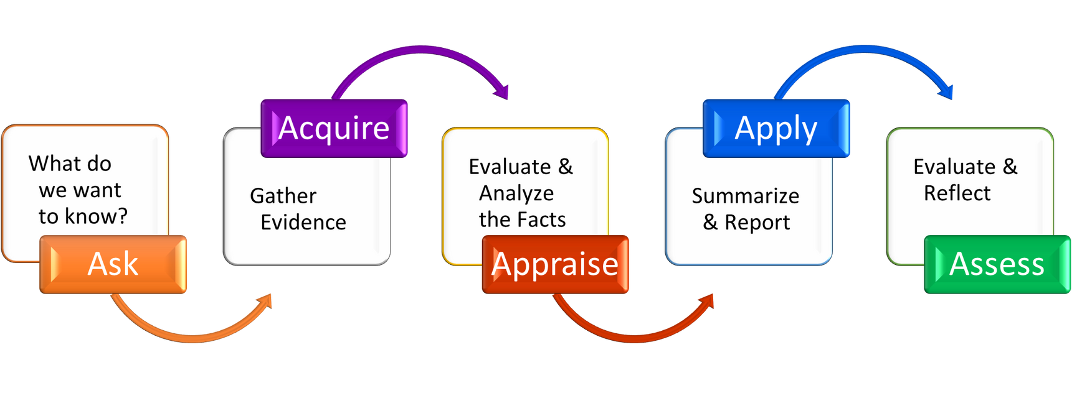
LEARNING OUTCOMES FOR STUDENTS
GOAL 1 VISUAL

Slide 6
LEARNING OUTCOMES FOR FACULTY
GOAL 2
FACULTY WILL DEMONSTRATE IMPROVEMENTS IN THEIR ABILITY TO:
Assess students' use of evidence in their courses

Slide 7
IMPLEMENTATION PLAN
Course Specific
University Wide
QEP Signature Assignment
QEP Signature Course
QEP Student Workshops & Resources
Faculty & Student Kickoff
QEP Student Guest Speakers
Faculty Development Series
Faculty Development Guest Speaker
Faculty Conference Funding
BLKBD-2000 Faculty Module
Infusion into Campus Events
QEP Success
YEAH!!

Slide 8
SIGNATURE ASSIGNMENTS
Faculty assessment of student learning improves both goals of the QEP. As directly related to both goals, QEP Signatures Assignments will be integral in the implementation process. Using the QEP Assignment Rubric, faculty can seek QEP Signature Assignment designation by achieving a benchmark score of 15/25 points on the QEP Assignment Rubric. Any faculty member throughout the university can seek signature assignment designation. Signature Assignments will help increase student learning by reinforcing the 5 A’s, informing the implementation processes, and providing data points for continuous improvement opportunities.

Slide 9
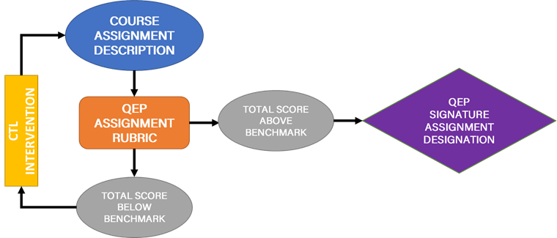
SIGNATURE ASSIGNMENTS

Slide 10
QEP SIGNATURE COURSE
Why be a QEP Signature Course?
Assists the university in raising quality and standards for student lifelong learning
Low commitment of time
High rewards
Portfolio builder
Monetary incentive ($200)

Slide 11
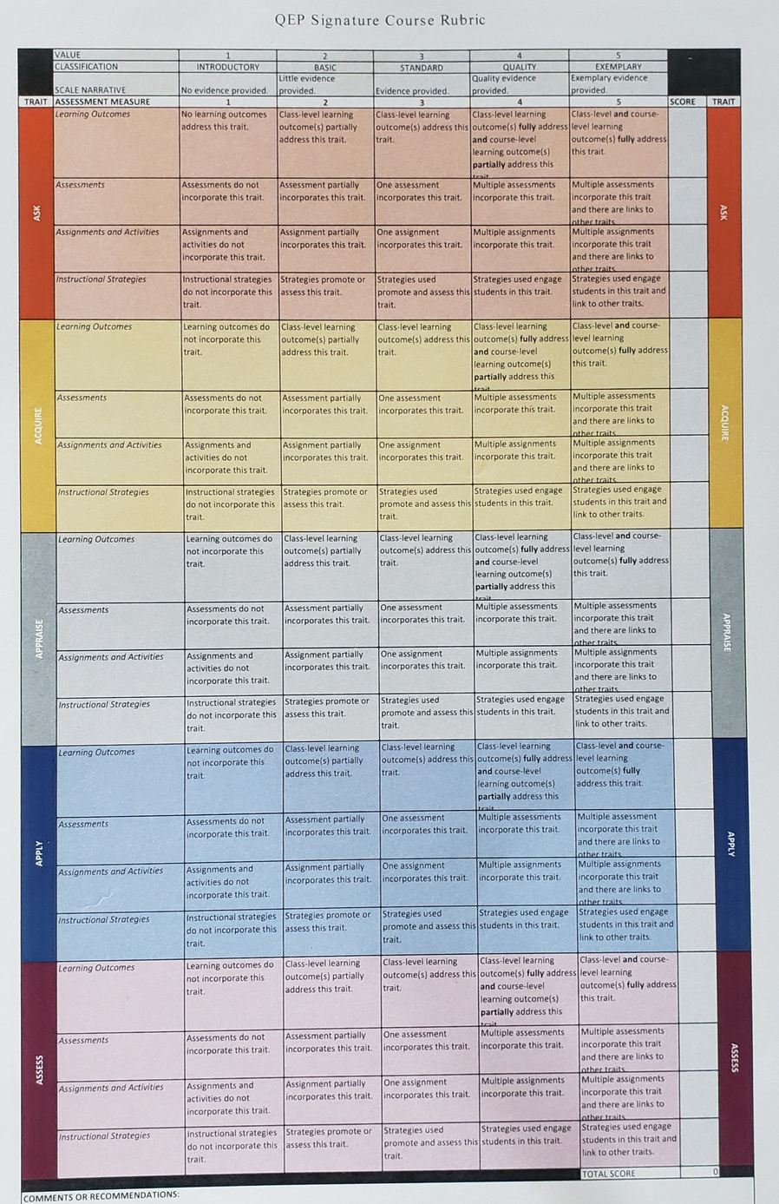
QEP SIGNATURE COURSE ASSESSMENT
Quick visual of the QEP Signature Course Assessment Rubric. Measurements are between 1 thru 5.
This is the measurement tool utilized for Signature Course rubric rating for each course to become a QEP Signature Course.

Slide 12
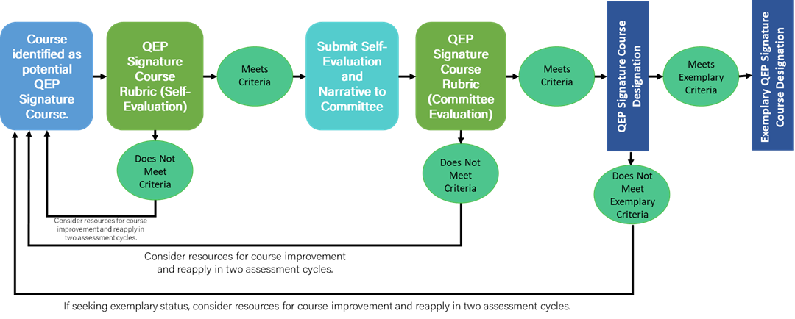
QEP SIGNATURE COURSE PATH

Slide 13
DOES YOUR COURSE HAVE?
Learning Outcomes - objectives that occur at various levels throughout the course and guide the learner throughout the learning process with use of the 5As (involves describing meaningful, observable, measurable knowledge and skills of course)
Assessments - formative and summative ways faculty provide feedback to students as a learning tool and incorporates the 5As individually and collectively (systematic process of examining and defining the course activities to what students should know at the end of class)
Assignments And Activities - opportunities for students to engage with the course content through discussion boards, group activities, or other learning with 5As being incorporated in multiple assignments
Instructional Strategies - including technologies and presentations on how class content is delivered and assessed with a learning environment incorporating the 5As

Slide 14
DO YOUR LEARNING OUTCOMES, ASSESSMENTS, ASSIGNMENTS, ACTIVITIES, AND INSTRUCTIONAL STRATEGIES INCORPORATE THE ESSENCE OF 5 A’S?
Inside, outside, up top, down low…. students eat, breathe, sleep, and bathe in the 5 A’s in my course.
To some extent throughout my course. I’d say I’m a solid incorporator of the 5 A’s already.
Yes, in a single session or two. But with a few tweaks, I can do more!
Partially but I’m ready to take the next step!
Not yet! But within the next 5 years, I can!

Slide 15
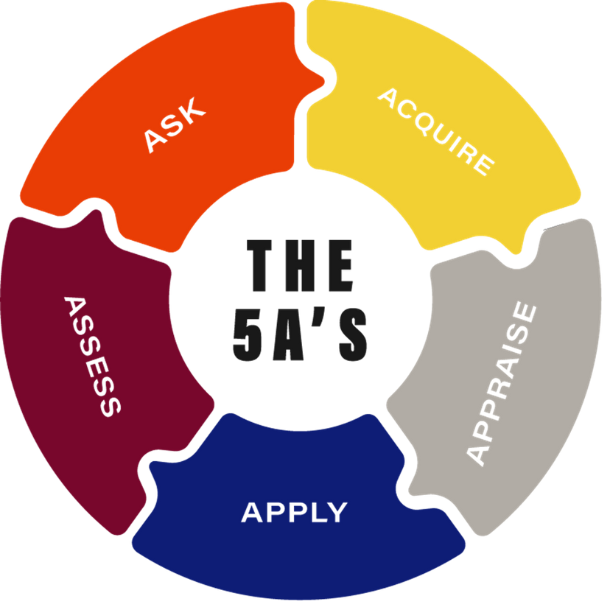
THEN YOUR COURSE CAN BECOME A
QEP SIGNATURE COURSE!

Slide 16
ASK

Slide 17
ACQUIRE

Slide 18
APPRAISE

Slide 19
APPLY

Slide 20
ASSESS

Slide 21
I have questions...
Who will be grading these?
What if my course isn’t data-driven, scientific, etc.?
How much extra work will this be?
Do I need to change my grading breakdown?
What support will be available?
QEP Rubric Raters
This framework is so flexible, which is why the committees chose it!
There will be a little bit, but the goal is to enhance what we are already doing… so let’s talk if you think this isn’t going to work in your course(s).
Not unless you want to. There is no plan to have QEP rubrics factor into your gradebook…. but if you want to, do!
We have faculty development workshops, student resources, conference funding, and more planned!

Slide 22
MY.PARKER.EDU
QEP PAGE
For latest updates, visit BLKBD-2000 for materials and video & QEP Page on MyParker, MyParkerLearn for more information
QEP - Parker University -
YouTube for Full QEP Plan

Slide 23
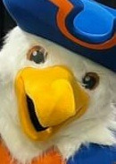
QUESTIONS?
Dr. Mandy Smith
QEP Manager
mandysmith@parker.edu
Dr. Ashley Long
QEP Director
along@parker.edu

Slide 24
THANK YOU
972-438-6932
mandysmith@parker.edu
my.parker.edu

